Slide 1
PROJECT MANAGEMENT TOOLS AND TECHNIQUES

Slide 2
What is Project Management?
Project Management is the process of defining, Planning ,organizing, leading and controlling the development of an Information System Project.
The goal of Project Management is to deliver an Information System that is acceptable to Users and is developed on time and within budget

Slide 3
Basic Tools
Organization
Project Lifecycle
Project Proposal
Work Breakdown Structure
Scheduling and visualization
Gantt Chart
PERT
Critical Path Method

Slide 4
PROJECT MANAGEMENT PROCESS PHASES
INITIATING THE PROJECT
PLANNING THE PROJECT
EXECUTING THE PROJECT
CLOSING DOWN THE PROJECT

Slide 5
1. PROJECT INITIATION
The first phase of Project Management
Process in which activities are performed to asses the Size, Scope, and Complexity of the Project and to establish procedures to support later Project activities.

Slide 6
PROJECT INITIATION ACTIVITIES
ESTABLISHING THE PROJECT INITIATION TEAM
ESTABLISHING A RELATIONSHIP WITH CUSTOMER
ESTABLISHING PROJECT INITIATION PLAN
ESTABLISHING MANAGEMENT PROCEDURES
ESTABLISH PROJECT MANAGEMENT ENVIRONMENT AND PROJECT WORKBOOK
Depending on the Project some of these Initial Activities may be unnecessary and some may be very involved.

Slide 7
2. PROJECT PLANNING
The Project Planning provides an overall framework for managing Project Costs and schedules.
Project Planning takes place at the beginning and at the end of each Project Phase.
Project Planning involves defining clear, discrete “Activities” or “Tasks” and the work needed to complete each Activity.
IF YOU FAIL TO PLAN, YOU PLAN TO FAIL!

Slide 8
2. PROJECT PLANNING
Project Planning involves defining clear, discrete “Activities” or “Tasks” and the work needed to complete each Activity.
An ACTIVITY is any work that has a beginning and an end. And requires the use of Project resources including people, time and money.
Activities are the basic units of work that Project Manager Plans, monitors so Activities should be relatively small and manageable.

Slide 9
2. PROJECT PLANNING ACTIVITIES
Describing Project Scope, Alternatives and feasibility
Dividing the Project into manageable tasks (WBS)
Estimating and creating a Resources Plan
Developing a Preliminary Project Schedule
Developing a Project Communication Plan
Determining Project Standards and Procedures
Identifying and Assessing Project Risks
Developing a Statement of Work
Setting a Baseline Project Plan.

Slide 10
2.1 DESCRIBING PROJECT SCOPE, ALTERNATIVES AND FEASIBILITY
PURPOSE: Is to understand the content and complexity of the Project.
2.2 DIVIDING THE PROJECT INTO MANAGEABLE TASKS (WORK BREAKEDOWN STRUCTURE)
Project must be divided into manageable tasks and then logically order them to ensure a smooth evolution between tasks.
The definition of tasks and their sequences is referred as the Work Breakedown Structure (WBS).
WBS is essential in Planning and executing the Project because it is the foundation for developing the Project Schedules (PERT / and GANNT chart) for identifying Milestones in the Scheduling and for managing Costs.

Slide 11
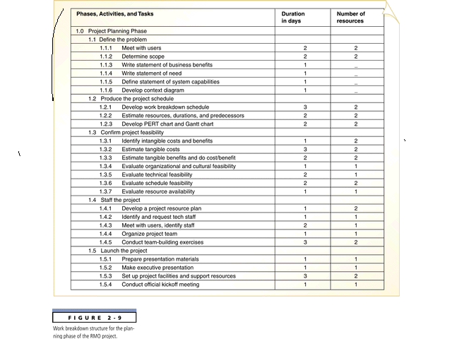
Work BreakedownStructure (WBS)

Slide 12
2.3 ESTIMATING RESOURCES AND CARRYING A RESOURCE PLAN
PURPOSE
Is to estimate Resource Requirements for each project Activity and use this information to create a Project Plan.
2.4 DEVELOPUNG A PRELIMINARY SCHEDULE
Using the information on Tasks and Resources availability to assign TIME ESTIMATES to each Activity in the WBS.
TIME ESTIMATES will allows you to create Target Starting and Ending Dates for the Project.
The Preliminary Schedule may be represented as a GANTT Chart or as a Network Diagram (ie. PERT/CPM Chart.

Slide 13
2.5 DEVELOPING A COMMUNICATION PLAN
PURPOSE
Is to outline the communication procedures among Management, Project team members and the Customer.
2.6 DETERMINING PROJECT STANDARD AND PROCEDURES
Specify hoe various Project Deliverables are produced and tested by you and your Project team.
Setting Project Standards and Procedures for work acceptance is a way to assure the development of a high quality System.

Slide 14
2.7 IDENTIFYING AND ASSESSING RISK
PURPOSE
Is to identify sources of Project Risk and to estimate the consequences of those Risks.
Risk might arise from the use of new technology, availability of critical resources, team member inexperience with technology or business area etc.
YOU SHOULD CONTINUALLY TRY TO IDENTIFY AND ASSESSS PROJECT RISK.
2.8 CREATING A PRELIMINARY BUDGET
You need to create a Preliminary Project budget that outlines the Planned expenses and Revenues associated with the Project.
The Preliminary Budget will be used for Project Justification.

Slide 15
2.9 DEVELOPING A STATEMENT OF WORK
Developed primarily for the Customer. It outlines work that will be done and clearly describes what the Project will deliver.
It is useful since all parties have a clear understanding of the intended Project Size, Duration and outcomes.
2.10 SETTING A BASELINE PROJECT PLAN
The Baseline Project Plan provides an estimate of the Project’s tasks and Resource requirements and is used to guide the next project phase Execution.
As new information is acquired during Project Execution, the Baseline Plan will be continue to be updated.

Slide 16
3. EXECUTING THE PROJECT
The third Phase in Project Management Process in which the Plans created in the prior Project Phases are put to action.
If you develop a high quality Project Plan, it is much more likely that the Project will be successfully executed.
KEY ACTIVITIES OF PROJECT EXECUTION
1. EXECUTING BASELINE PROJECT PLAN
MONITORING PROJECT PROGRESS AGAINST THE BASELINE PLAN
MONITORING CHANGES TO BASELINE PLAN
MAINTAINING THE PROJECT WORKBOOK
COMMUNOCATING THE PROJECT STATUS.

Slide 17
4. CLOSING DOWN THE PROJECT
The final Phase of Project Management process which focuses on bringing a Project to an end.
Closedown is a very important activity since a Project is not complete until it is closed and it is at closedown that projects are deemed a success or failure.
Projects can conclude with a natural or unnatural termination.
Natural termination occurs when the requirements of the Project have been met and thus the Project completed and is a success.
An Unnatural termination occurs when the Project is stopped before natural completion.

Slide 18
4. CLOSING DOWN THE PROJECT
PROJECT CLOSEDOWN ACTIVITIES
Closing Down the Project
Conducting Post-project Review
Closing the Customer Contract

Slide 19
REPRESENTING & SCHEDULING PROJECT PLANS
The Most commonly used methods are :-
GANTT CHART
NETWORK DIAGRAMS (PERT/ CPM)

Slide 20
GANTT CHART
Developed in 1917 by Henry Gantt as tool for managing factory production
Depicts start times and lengths of major tasks (i.e. WBS)
Can be used to monitor ongoing progress

Slide 21
GANTT CHART
A graphical representation of a Project that shows each task as a horizontal bar whose length is proportional to its time for completion.
A GANTT Chart is a horizontal bar chart that illustrates a Project schedule.
In the GANTT Chart Time is displayed on the horizontal axis and the Tasks/ Activities are arranged vertically from top to bottom, in order of their start dates.
A detailed GANTT Chart for a large project might be quite complex and hard to understand. To simplify the chart Project manager can combine related activities into one Task.

Slide 22
GANTT CHART
A graphical representation of a Project that shows each task as a horizontal bar whose length s proportional to its time for completion.
GANTT CHART do not show how tasks must be ordered (precedence) but simply show when a task should begin and should end
GANTT Chart is often more useful to for depicting relatively simple projects or sub projects of a large project, the activities of a single worker, or for monitoring the progress of activities compared to scheduled completion dates..

Slide 23
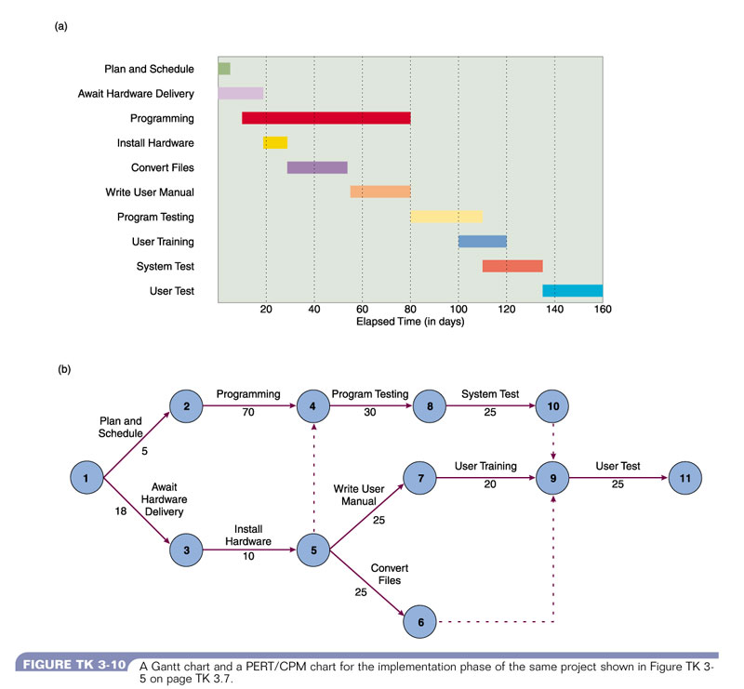
GANTT CHART

Slide 24
NETWORK DIAGRAM
Is a graphical depiction of Project tasks and their inter-relationships.
The distinguishing feature of a Network Diagram is that the ordering of Tasks is shown by connecting with its predecessor and successor tasks. tasks.
Network Diagramming is a Critical Path Scheduling Technique used for controlling resources.
CRITICAL PATH SCHEDULING
A scheduling technique whose order and duration of a sequence of task activities directly affect the Completion Date of a Project

Slide 25
NETWORK DIAGRAM
You would use a Network Diagram when Project Tasks:-
Are well defined and have clear beginning and end point
Can be worked on independently of other tasks
Are ordered
Serve the purpose of project

Slide 26
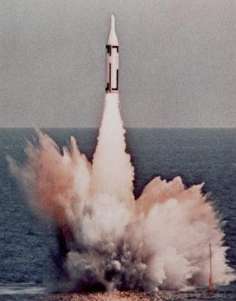
Program Evaluation & Review Technique (PERT)
Developed in 1958 for Polaris missile program
Used extensively in Cold War projects such as CORONA and SR-71
Time estimates, scheduling, and interdependencies of WBS tasks
Visualized in network model

Slide 27
PROGRAM EVALUATION REVIEW TECHNIQUE (PERT)
One of the most difficult and most error prone activities when constructing a Project Schedule is the determination of the TIME DURATION for each task within a Work Breakdown Structure (WBS), specially when there is a high degree of complexity and uncertainty about a task.
PERT is a technique used to calculate the Expected Time for a tasks.
PERT is a technique that uses Optimistic time (O), Pessimistic time (P) and Realistic Time (R) estimates to calculate the EXPECTED TIME (ET) or a particular task.

Slide 28
PROGRAM EVALUATION REVIEW TECHNIQUE (PERT)
PERT is a technique that uses Optimistic time (o), Pessimistic time (p) and Realistic Time (r) estimates to calculate the EXPECTED TIME (ET) or a particular task.
The Optimistic time (o) and Pessimistic time (p) reflects the minimum and maximum possible periods of time for an activity to be completed.
The Realistic time (r) or the Most likely time , reflects the Project manager’s “Best Guess” of the amount of time required for a task completion.

Slide 29
PROGRAM EVALUATION REVIEW TECHNIQUE (PERT)
CALCULATING EXPECTED COMPLETION TIME (ET)
o + 4r + p ET = ------------------- 6
Because the expected Completion time should be closer to the realistic time (r), it is typically weighed Four times more than the Optimistic time (o) and the Pessimistic time (p). Once you add these values together , it must be divided by 6 to determine the Expected Time for a task.

Slide 30
HOW TO CONSTRUCT A NETWORK DIAGRAM (PERT / CPM)
DEVELOPING A NETWORK DOAGRAM IS A FOUR STEP PROCESS:-
Identify each Project Activity to be completed
Determine Time estimates and calculate Expected Completion Time for each Activity
For each Activity, identify the immediate predecessor Activities
Enter the Activities with connecting arrows based on Dependencies and calculate Start and End times based on Duration and Resources.

Slide 31
PERT CHART SYMBOLS
PERT Chart is consisted of TASKS and EVENTS. An EVENT is called a Milestone, representing a point in time, such as the Start or Completion of a Task.
A circle or a Rectangle shape NODE is used to represent an EVENT.
Every PERT Chart has one Beginning and one End NODE that represents the Start and Finish of a Project.
The Earliest and Latest Time is both Zero in Starting Event.
A TASK also called Activity, is depicted by an ARROW Connecting Events. A Dashed Arrow represents a DUMMY TASK which is the dependancty between two events without requiring ant resource.

Slide 32
PERT CHART SYMBOLS
SLACK TIME:- The Slack Time available for any Task is equal to the difference between the Earliest completion Time (ECT) and the Latest Completion Time (LCT)
SLACK TIME = (LCT – ECT)
CRITICAL PATH
Is a sequence of Dependent Tasks that have the Largest sum of Estimated Time (ET). IT is the Path that has no Slack Time built in.
The Critical Path on PERT chart is shown with thick Dark line.
To find the Critical Path begin with identifying all alternative paths that exist from Event 1 to the Final Event.

Slide 33
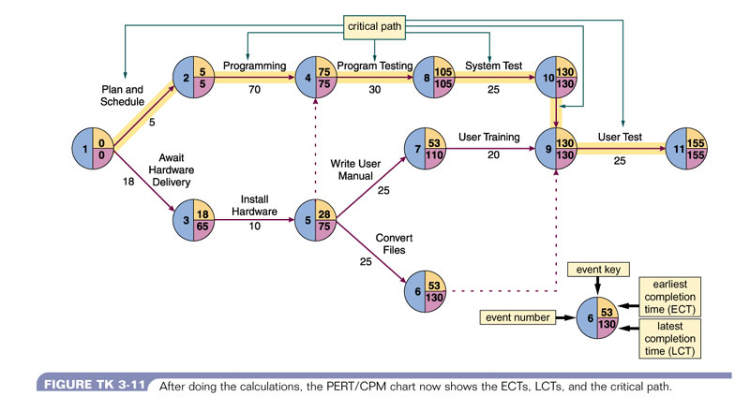

Slide 34
Critical Path Method (CPM)
Similar to PERT (and developed at same time)
Different emphases
“Critical path”: Longest set of tasks – determines overall time for project
“Crash” time estimates: Shortest time required in “emergency” situation

Slide 35
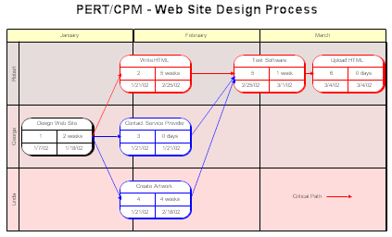
CPM Chart
PERT charts are also called Critical Path Management (CPM) or Critical Path Analysis (CPA) charts.
The PERT chart on the left places the time to do a task, starting date, and ending date inside the task box.
The horizontal axis has time in months and the vertical axis shows who will be doing the work.
Time estimates given on nodes
Including crash times
Critical path highlighted

Slide 36
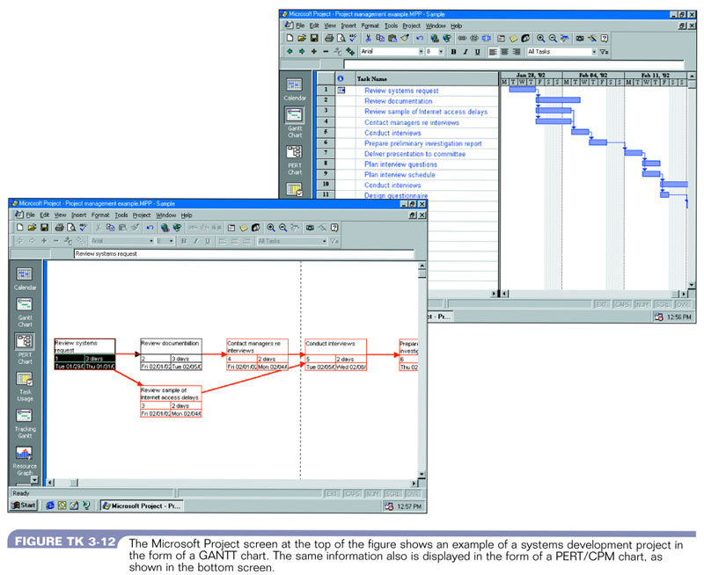
GANTT CHART vs PERT CHART

Slide 37
GANTT CHART vs PERT CHART
GANTT chart visually shows the duration of Tasks whereas a PERT chart visually shows the sequence dependencies between tasks.
GANTT visually shows the Time overlap of Tasks whereas a Network does not show time overlap but does show which tasks could be done in parallel.
Some form of GANTT chart can visually show Slack Time available within an Earliest Start and Latest finish time..
Most Project Managers find PERT very helpful for scheduling, monitoring and controlling Projects.
PERT is recommended for Large Projects with high intertask dependencies and the GANTT chart for simpler Projects.
Most Project Management Case Tools nowadays (eg. MS-Project ) allow the best feature of PERT to be incorporated into GANTT Charts.

Slide 38
Implications
Project “Success” can be measured
Can use customer satisfaction as the metric
In business, can use sales
In problem-solving, can establish metrics at each project phase
Can tie goals to metrics
BUT No Child Left Behind

Slide 39
Software
Dozens of programs!
Commercial desktop
Microsoft Project
Primavera
Open source
dotProject
Web-based
eProject

Slide 40
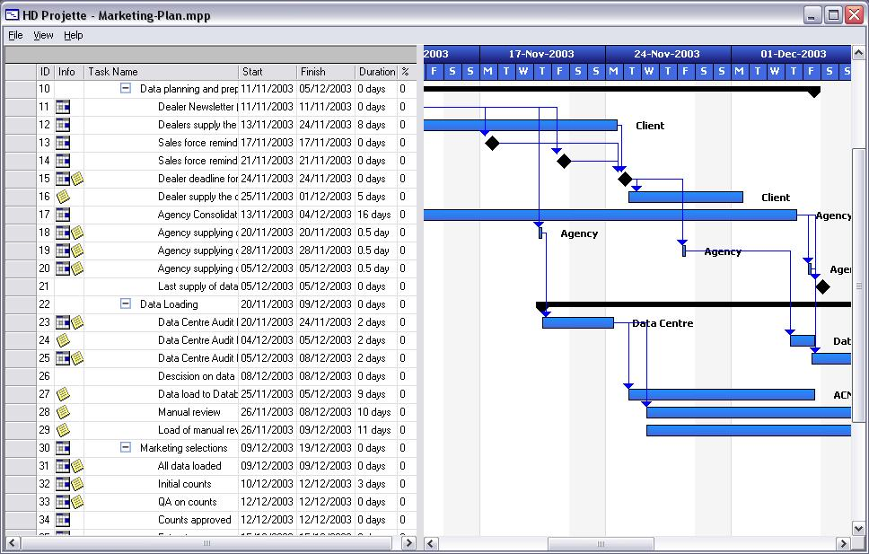
Examples: Projette (add on to MS Project)

Slide 41
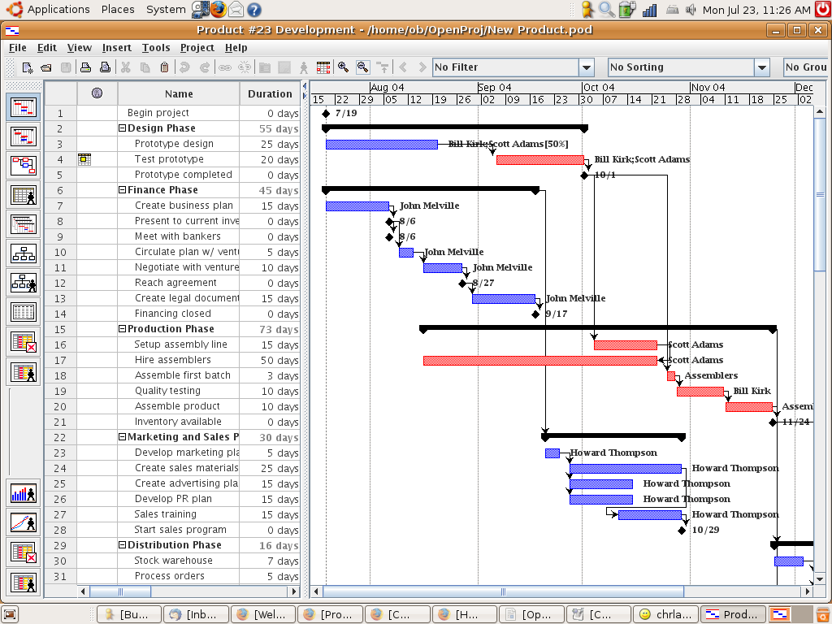
Example: Open Project

Slide 42
Some newer project methods
Brainstorming
Rapid prototyping
Focus groups
Scenario-based planning
SWOT
Red teaming
Delphi methods
Source code control systems
Fault tolerant systems planning

